Slide 1


Slide 2
What is CloudHour?
Objective of CloudHour
Round-table discussion
Focus on a few key topics
Why It's Important
Rapid changes in cloud security and tech
Stay updated and connected for growth as community
How it will benefit the community
Real-time engagement with hosts and community members
Ask open questions and speak your opinion
Opportunity to affect the next agenda
Notes:
Objective of CloudHour
The objective of CloudHour is to create a collaborative space where professionals can come together to discuss, learn, and share insights on the most pressing topics in cloud security and modern workplace technology.
Why its important
CloudHour is important because, in the rapidly evolving landscape of cloud security and workplace technologies, staying updated and connected is crucial for career growth and organizational resilience
How it will benefit the community
By attending CloudHour, community members will have the unique opportunity to engage with industry experts in real-time, ask questions, network with like-minded professionals, and even have the chance to contribute their own expertise by becoming guest speakers in future episodes.

Slide 3

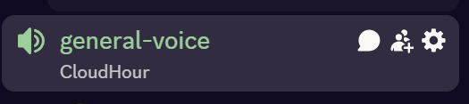
If you prefer to not talk or be asked questions press mute
press mute just mute the mic
If you preferer to chat press

Slide 4
Links to share
Application-Based Authentication (Entra Connect)
Endpoint Privilege Management – Explicit Deny Rules
Decommissing on-prem AD (Entra News)
Microsoft Intune Connector Update
Microsoft Intune – Business Premium Tips
MS EMS Community Podcast (Venkata)
Entra ID Attack Paths
Notes:
Microsoft Entra Connect: Version release history - Microsoft Entra ID | Microsoft Learn
What's new in Microsoft Intune | Microsoft Learn
https://entra.news/p/decommissioning-on-prem-ad-lessons
Microsoft Intune Connector for Active Directory security update | Microsoft Community Hub
https://youtu.be/rtw_5HLCLCY?si=C2WwAvv7kPqcr9Bs
https://youtu.be/gjUVQpws5pg?si=hX-HL8ARNlLCWrhD
https://www.jbaes.be/attack-paths/

Slide 5
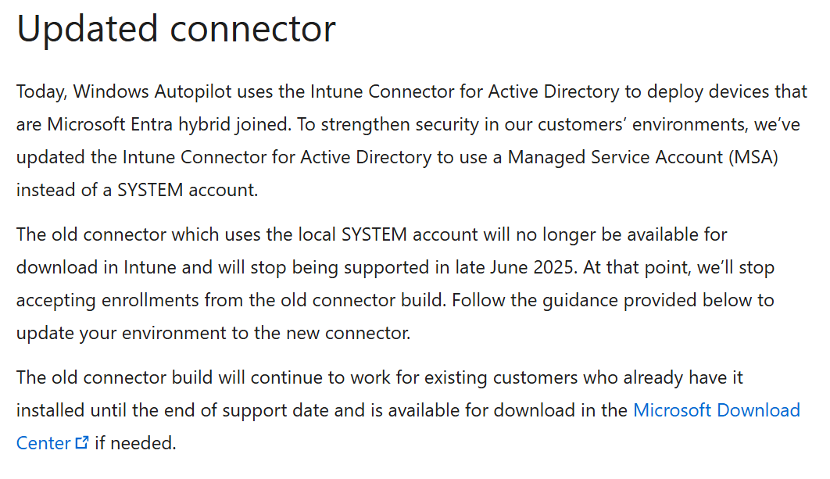
IMPORTANT: Intune Connector Update
Notes:
If you are doing hybrid Autopilot, you might want to check this out!
Make sure to update your connector, otherwise it will stop working late June.

Slide 6
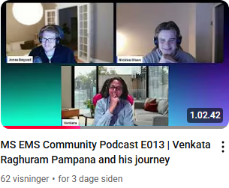
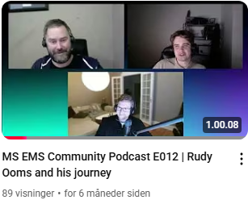
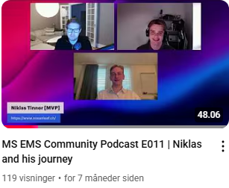
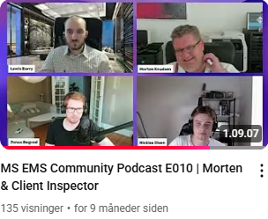
Want to join MS EMS Community Podcast?
Pre-recorded podcast about your journey and technical insights.
All from tech enthusiasts, Microsoft MVPs/employees and students!
Reach out to Jonas/Nicklas!

Slide 7
Agenda
WWDC25 – Apple Device Management
Microsoft SSO (Linux)
Windows Autopatch (Hands-on)
Devices stuck enrolling into the service with Rudy
OAuth App Activities with Jonas
Community Tools

Slide 8
WWDC25 – Apple Device Management
Declarative App Management.
Device reassignment to a new MDM without wiping.
PSSO integration with setup assistant.
Authenticated Guest Mode (Shared mac deployments)
User data is erased after logout.
Notes:
What’s new in Apple device management and identity - WWDC25 - Videos - Apple Developer

Slide 9
Microsoft SSO (Linux)
How many uses Linux today in their environment?
How many is blocking it via CA as a unsupported OS?
Register your Linux devices into Entra ID and Intune and make use of all the features.
Gives the possibility of making use of SSO on supported applications.
Notes:
Microsoft single sign-on For Linux - Microsoft Entra ID | Microsoft Learn

Slide 10
Windows Autopatch
Available now for Business Premium and A3 licenses.
How many has configured it today?
How was it? Was it difficult, or was it easy?
Let's look at how to configure it!

Slide 11
Bonus Tip: Stuck enrolling into the service!
What should you do, if your device is stuck enrolling Rudy?

Slide 12
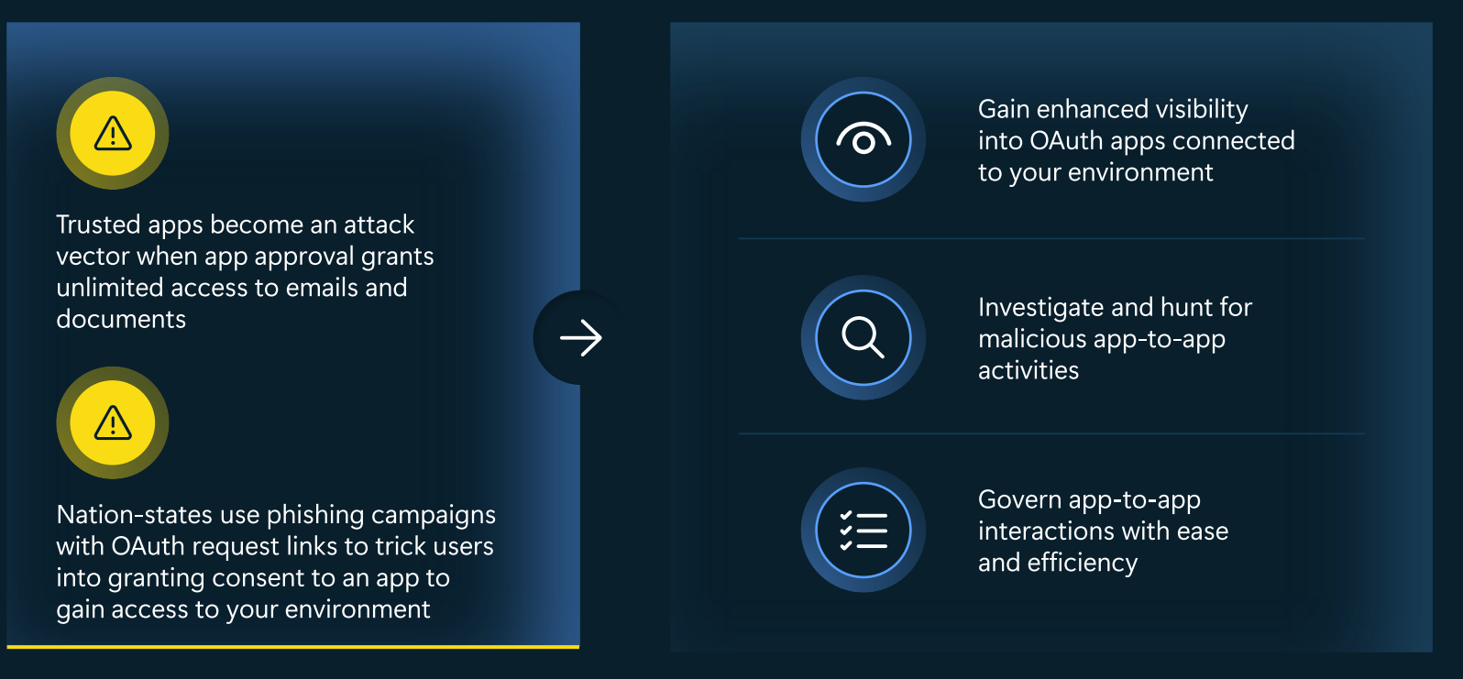
OAuth exploits are evolving

Slide 13
What is a CASB?
A security layer that monitors and enforces policies between users, devices, and cloud apps.
Visibility
Leverage Proxy or firewall logs to monitor
Between users and devices
Control & Enforcement
Apply policies
Tracks activity
Protects data across all devices
Users
SaaS
Devices
Notes:
MDA acts as the brain between endpoint signals, identity risks, and cloud app usage. It sees risky behavior across Microsoft 365, Defender, Entra ID, and can even connect to external apps like Salesforce or AWS.
Cloud Access Security Broker

Slide 14
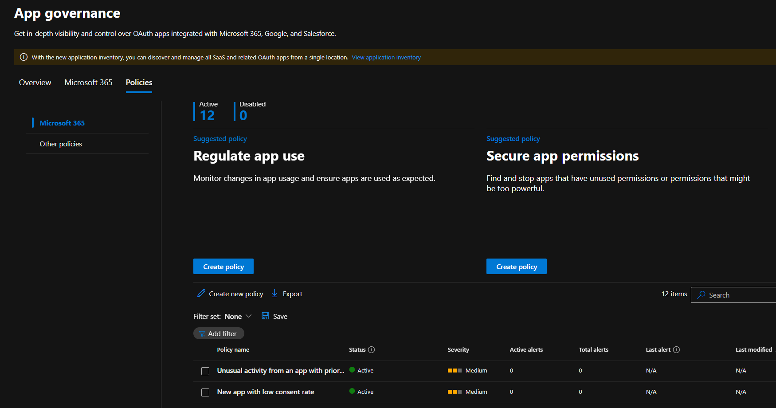
Discover and manage OAuth Apps
See App origin
Create custom policies
Understand App privileges and access
Manage high-risk permissions
App Discovery policy

Slide 15
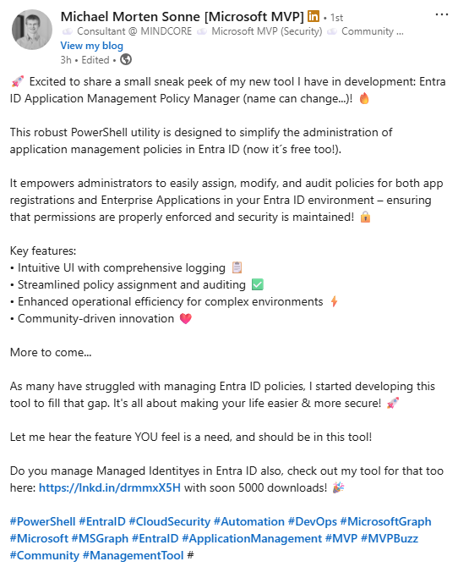
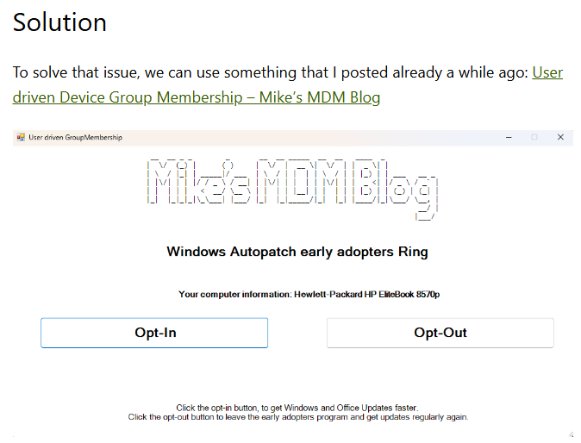
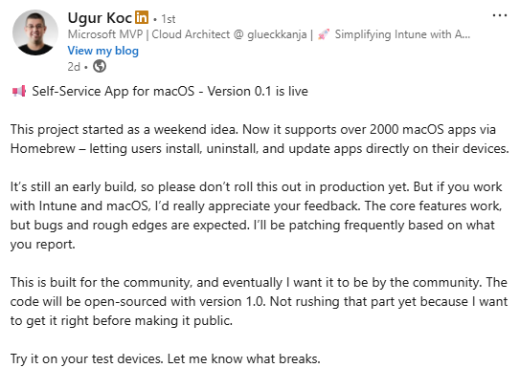
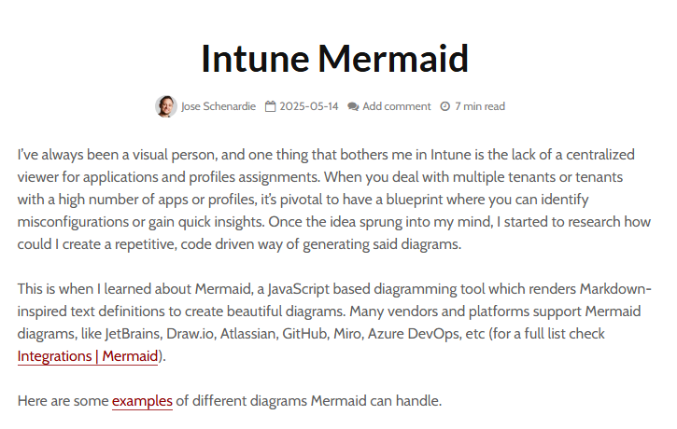
Community Tools
Entra ID Application Management Policy Manager (Michael Morten Sonne)
IntuneBrew (Ugur Koc)
Windows Autopatch Groups user opt-in (Michael Meier)
Intune Mermaid (Jose Schenardie)
Notes:
Intune Mermaid - MSEndpointMgr

Slide 16
Upcoming spotlight events!
Show in discord
Remind of next Coudhour
Ask for spotlight speaker requests

